Slide 1
Predicting NSAP Scheme Eligibility Using Machine Learning
CAPSTONE PROJECT
Presented By:
Student Name-Arjeeth M S
College-Seshadripuram Degree College
Department-BCA

Slide 2
OUTLINE
Problem Statement
Proposed System/Solution
System Development Approach
Algorithm & Deployment
Result
Conclusion
Future Scope
References

Slide 3
Problem Statement
The National Social Assistance Programme (NSAP) is a welfare scheme by the Government of India that provides financial support to elderly, widows, and disabled individuals from below poverty line (BPL) families. However, identifying eligible beneficiaries manually is time-consuming, error-prone, and often lacks transparency.
The goal of this project is to develop a machine learning-based predictive model that can accurately determine the eligibility of individuals for the NSAP scheme based on socio-economic and demographic features. This automated system aims to assist government agencies in efficient and fair distribution of benefits by minimizing human bias and speeding up the eligibility verification process.

Slide 4
Proposed Solution
To address the inefficiencies in manually determining eligibility for the NSAP scheme, we propose building a machine learning-based classification model that can predict whether an individual is eligible or not based on relevant input features. The proposed solution involves the following steps:
Data Collection Gather a dataset containing socio-economic, demographic, and health-related attributes
Data Preprocessing
Handle missing values
Encode categorical variables
Normalize or standardize numerical features
Split data into training and testing sets
Model Selection & Training Train multiple classification models (e.g., Logistic Regression, Decision Tree, Random Forest, Support Vector Machine) on the training dataset and compare their performance using metrics like accuracy, precision, recall, and F1-score.
Model Evaluation & Optimization
Use techniques like cross-validation to ensure robustness
Fine-tune hyperparameters for optimal performance
Deployment Develop a simple user interface (web or desktop) where officials can input an individual’s data and get real-time eligibility predictions from the model.
Interpretability & Transparency Use explainable AI techniques (like SHAP or LIME) to help users understand the reasons behind the model’s decisions, ensuring transparency in eligibility prediction.

Slide 5
System Approach
System requirements:
IBM Cloud
IBM Watson studio for model development and deployment
IBM cloud object storage for dataset handling

Slide 6
Algorithm & Deployment
Training Phase:
The dataset is split into several random subsets.
Multiple decision trees are trained on different subsets of data and features.
Each tree independently predicts eligibility (Yes/No).
Prediction Phase:
For a new individual's data, each tree makes a prediction.
The final output is decided by majority voting among all the trees.
Evaluation:
Accuracy, precision, recall, and F1-score are used to evaluate model performance.
Cross-validation and hyperparameter tuning improve model robustness.
.

Slide 7
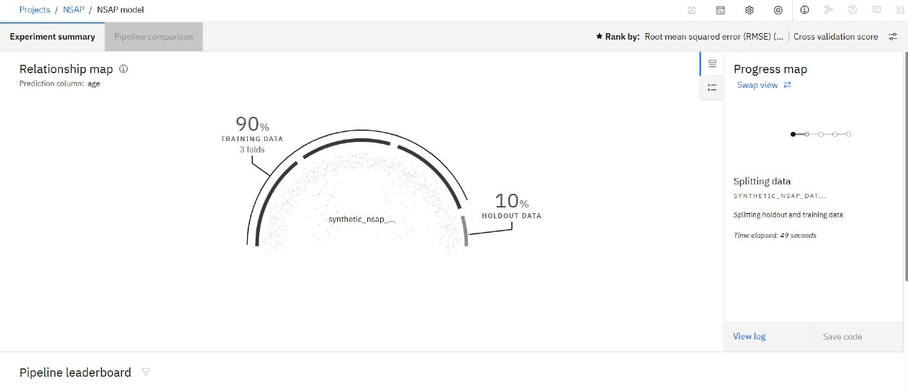
Result

Slide 8
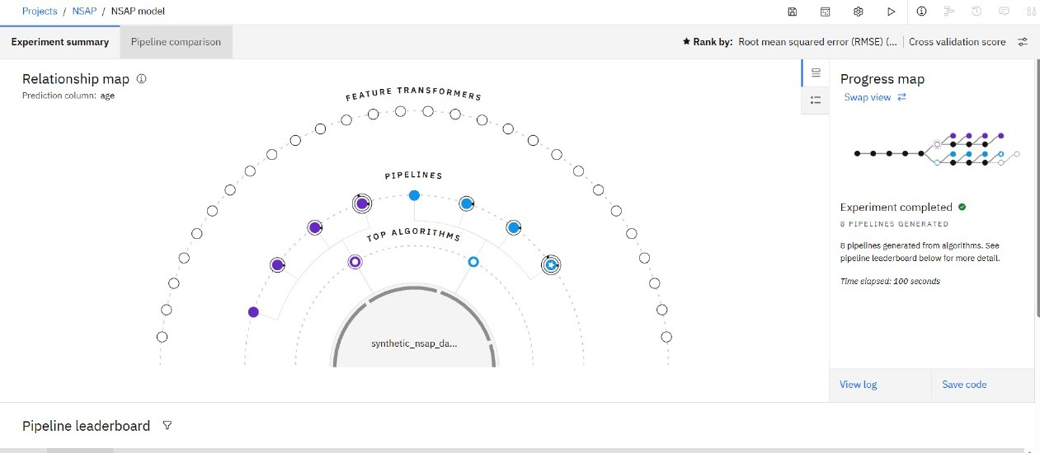

Slide 9
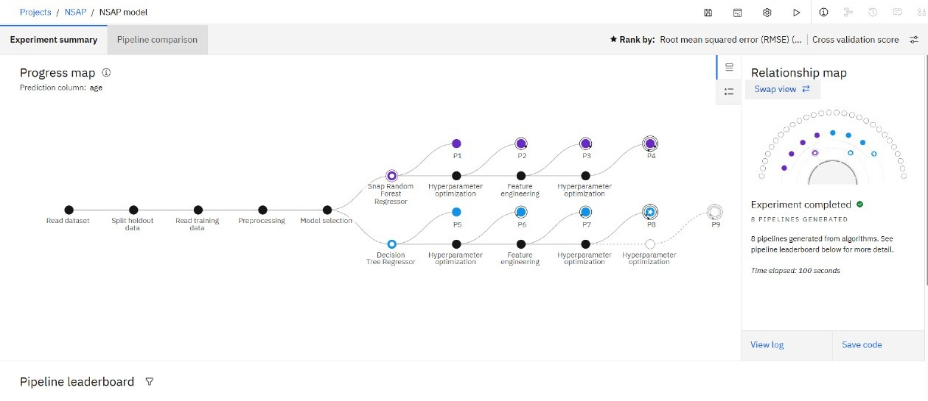

Slide 10
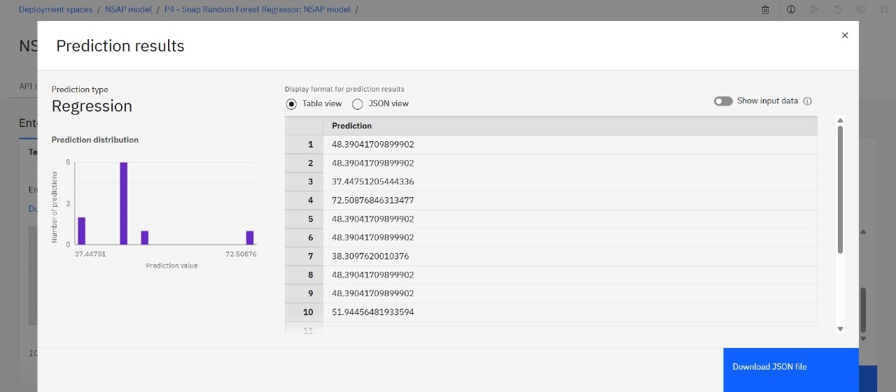

Slide 11
Conclusion
The proposed machine learning model provides an efficient and reliable way to predict eligibility for the NSAP scheme. By analyzing socio-economic and demographic data, the model automates the decision-making process, reducing manual errors and ensuring faster, fairer beneficiary identification. With proper deployment and explainability tools, this system can support government agencies in improving transparency and targeting the right individuals for welfare benefits.

Slide 12
Future scope
Integration with Government Portals: Link the model with real-time government databases for automated beneficiary screening.
Model Improvement with More Data: Incorporate larger and more diverse datasets for higher accuracy and generalization.
Inclusion of Geospatial and Temporal Data: Use location-based trends and time-series analysis to improve eligibility prediction.
Mobile App Deployment: Develop a lightweight mobile version for use in rural and remote areas by field workers.
Real-time Feedback Loop: Use feedback from officials and beneficiaries to continuously refine the model.
Extension to Other Welfare Schemes: Adapt the model framework to predict eligibility for other government assistance programs.

Slide 13
References
Government of India, Ministry of Rural Development – National Social Assistance Programme (NSAP) Portal.
Breiman, L. (2001). Random Forests. Machine Learning Journal.
Ribeiro, M. T., Singh, S., & Guestrin, C. (2016). "Why Should I Trust You?": Explaining the Predictions of Any Classifier.
UCI Machine Learning Repository – Public Datasets for Machine Learning Research.
Articles and tutorials from Towards Data Science and Medium on ML algorithms and model evaluation.

Slide 14
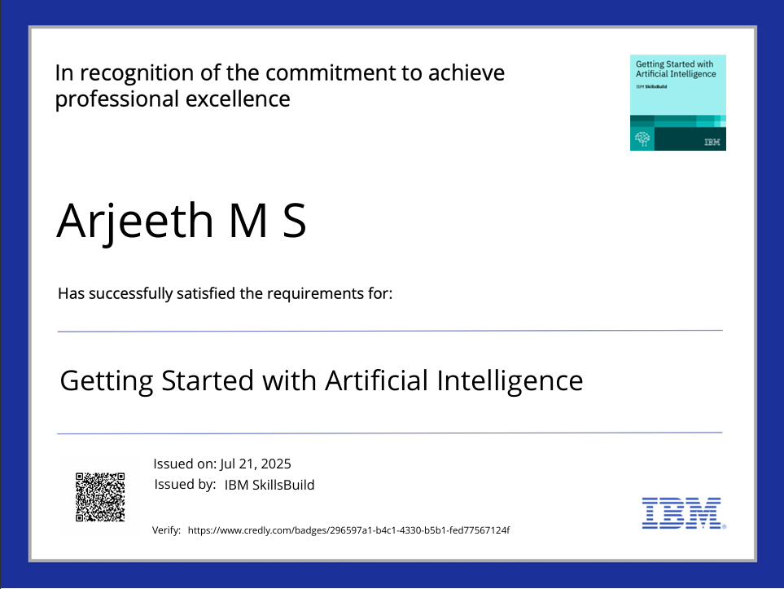
IBM Certifications

Slide 15
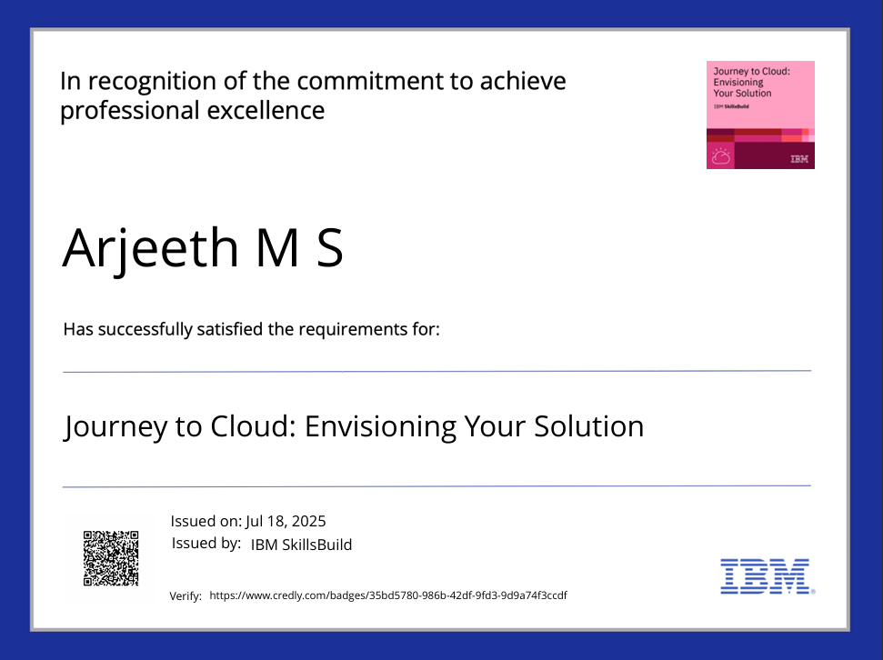
IBM Certifications

Slide 16
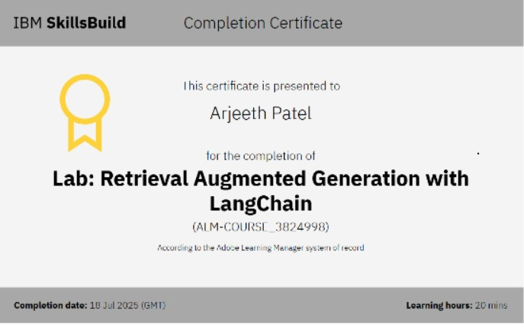
IBM Certifications

Slide 17
THANK YOU

